Slide 1


Data Analysis Presentation: Identifying Top 5 Popular Content Categories

Slide 2


Today's agenda
Agenda:Introduction and Key Brief Points
Defining the Problem
Analytics Team Overview
Process and Methodology
Insights and Recommendations
Next Steps

Slide 3

Key Points from the Brief:
Client requires an analysis of content categories.
Objective: Identify the top 5 categories by popularity, as quantified by the total "Score" of reaction types.
Data Requirements:
Content ID, category, content type, reaction type, and reaction score.
Data Model Recap:
Popularity = Total "Score" aggregated for each content category.
Project Recap

Slide 4

Problem
Key Points from the Brief:
Client requires an analysis of content categories.
Objective: Identify the top 5 categories by popularity, as quantified by the total "Score" of reaction types.
Data Requirements:
Content ID, category, content type, reaction type, and reaction score.
Data Model Recap:
Popularity = Total "Score" aggregated for each content category.

Slide 5



Andrew Fleming: Chief Technical Architect
Oversaw data infrastructure and ensured data integrity.
The Analytics team
Marcus Rompton: Senior Principal
Provided strategic direction for the analysis.
Abiola Lawal: Data Analyst
Cleaned, modeled, and analyzed the data to derive actionable insights.

Slide 6
Data Collection: Identified and extracted relevant datasets (content ID, category, content type, reaction type, and reaction score).
Process
1
Data Cleaning and Preparation: Removed duplicates, handled missing values, and merged datasets.
2
Data Modeling: Aggregated reaction scores for each content category.
3
Analysis: Ranked categories based on their total scores.
Visualized results to highlight the top 5 categories.
4
5
Tools Used: Excel, Power BI

Slide 7

Insights
16
1897
JANUARY
Unique Categories
Animal Reactions
Month with most post

Slide 8
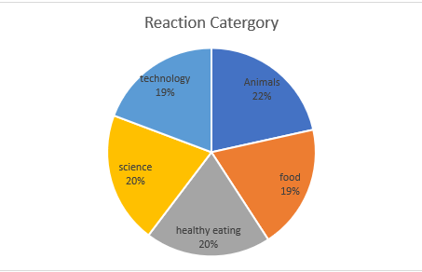

Slide 9
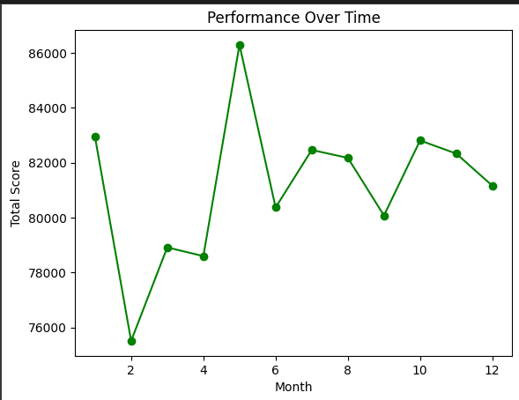
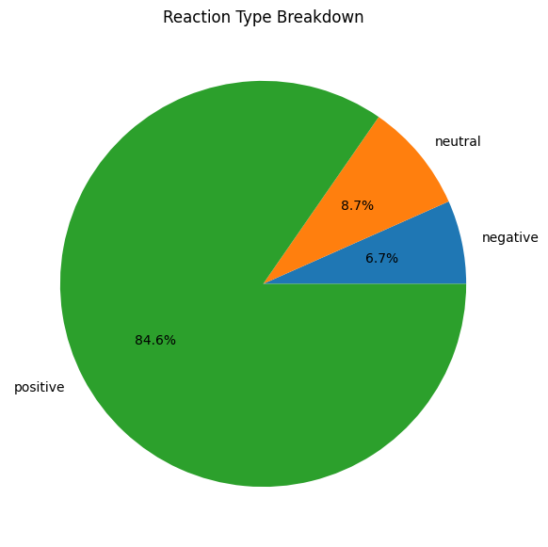

Slide 10

Reaction Type Analysis:
Analysis:
We examined the types of reactions (positive, neutral, and negative) for each piece of content. The "Reaction Type Score" summarizes the feelings tied to each interaction.- The data reveals how audiences respond to different content types
Insight:
More positive reactions indicate user satisfaction and engagement. High negative reactions suggest some content may not appeal, possibly due to relevance, tone, or quality.
Neutral reactions may show that users are indifferent to the content.
Next Steps:
Optimize Content: Focus on creating content that generates positive reactions and identify what drives them.
Address Negatives: Investigate negative feedback and revise the content strategy accordingly.
Improve Neutral Content: Change the format, visuals, or message of content with neutral reactions to encourage stronger response
Summary

Slide 11
Performance Over Time Analysis:
We examined content performance monthly, focusing on total "Reaction Type. Score." This helps identify trends in user engagement and associate performance changes with specific content or external factors like holidays
Insight:
High performance often aligns with specific content types or campaigns. A decline may indicate content fatigue or audience disengagement, prompting a need to adjust the strategy
Next Steps:
Capitalize on High Performance: Schedule future content around high engagement periods.
Investigate Declines: Analyze downward trends to determine causes and adapt the content strategy.
Test New Formats: Experiment with different content formats during declines to capture audience interest again.
Summary

Slide 12
Reaction Type Breakdown Analysis:
Analysis:
We categorized reactions by sentiment (positive, negative, neutral) to evaluate their contribution to overall engagement. This helps us understand how well the content meets audience expectation
Insight:
A high percentage of positive reactions indicates strong engagement and satisfaction, while dominant neutral or negative reactions highlight areas needing improvement.
Next Steps:
Increase Positive Sentiment: Identify successful elements in positive content and apply them to others.
Address Negative Sentiment: Improve content with higher negative reactions by enhancing relevance and quality.
Rework Neutral Content: Make neutral reactions more engaging through better storytelling and visuals.
Summary

Slide 13
Thank you!
ANY QUESTIONS?

